Slide 1

P718 - Adventure Works Analysis

Slide 2

Agenda
Introduction
Data Overview
Objectives: KPIs and Analysis/Actionable
Financials
Recommendation and Insights
Conclusion

Slide 3
Introduction
Adventure Works is a global company specializing in outdoor products such as bicycles, apparel, and accessories, with a diverse customer base.
Focus Area:
The company conducts Sales Analysis to evaluate performance based on product, customer, and region over time.
Challenges:
Analyzing product performance across various regions.
Understanding customer purchasing patterns and preferences.
Identifying sales trends and seasonal patterns.
Leveraging historical sales data for improved forecasting and decision-making.

Slide 4
Data Overview
Dataset Overview:
The Sales Analysis report is based on 8 Excel files, of which 2 contain Sales data spanning 5 years.
Data Cleaning & Pre-processing:
Data cleaning was performed using Power Query Editor, where we encountered the following issues:
Missing product categories and sub-categories for certain products.
Missing French and Spanish product names for some products, which remain unaddressed.
Data Modelling & Reporting:
Post-cleaning, data modelling was done in Tableau to prepare the final sales report. We also utilized MySQL and Power BI for additional analysis and data visualization.

Slide 5
Data Overview (contd.)
Key Columns:
ProductKey: Unique identifier for Products.
CustomerKey: Unique identifier for Customers.
OrderDateKey: Date of the sale transaction (linked to DimDate).
SalesTerritoryKey: Unique Identifier for Territory
ProductSubCategoryKey: Unique identifier for Product Category (linked to DimProduct)
ProductCategoryKey: Unique identifier for Product Sub-Category (linked to DimProductSubCategory)
Overall Timeline:
Timeframe: The data covers the period from 2010 to 2014, allowing us to analyze sales trends over 5 years.
Tables in the Dataset:
Sales: Contains transactional sales data.
DimProduct: Product information (e.g., product, descriptions).
DimProductSubCategory: Product Sub-category information (e.g., product sub-categories, descriptions).
DimProductCategory: Product Category information (e.g., product categories, descriptions).
DimCustomer: Customer details (e.g., name, address, contact, education).
DimSalesTerritory: Geographical regions where the sales occur.
DimDate: Calendar date dimension for analyzing time-based trends (dates, months, years).
Overall Data:
The dataset contains 60,000 rows of sales transactions.
Total Products are 606 while 307 products were part of Sales data

Slide 6
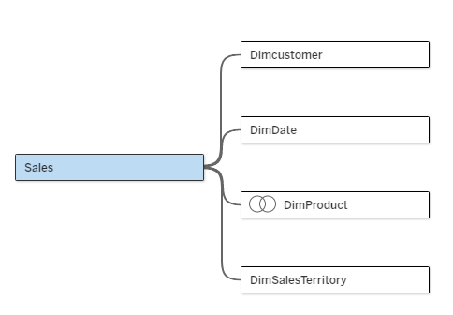
Data Structure (Tables)
Sales Table:
Columns: SalesAmount, ProductKey, CustomerKey, OrderDateKey, Quantity, etc.
DimProduct Table:
Columns: ProductKey, EnglishProductName, etc.
DimProductSubCategory:
Columns: ProductSubCategoryKey, EnglishProductCategoryName, etc.
DimProductCategory:
Columns: ProductCategoryKey, EnglishProductCategoryName, etc.
DimCustomer Table:
Columns: CustomerKey, CustomerName, Address, etc.
DimSalesTerritory Table:
Columns: SalesTerritoryKey, SalesTerritoryRegion, SalesTerritoryCountry, etc.
DimDate Table:
Columns: DateKey, Date, Month, Quarter, Year, etc.

Slide 7
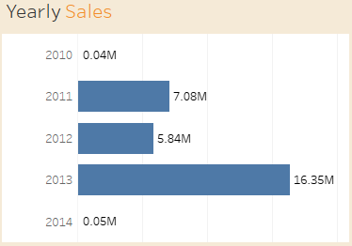



KPIs: Key Insights & Analysis/Actionable
Insights
Significant Growth (2010-2013): Sales grew substantially from $0.04M in 2010 to $16.35M in 2013.
Actionable
Project 2014 Sales: Estimate full-year sales based on the one-month data and historical trends.
2013: Peak Performance: Achieved record sales of $16.35M.
2014: Partial Data: Represents only one month of sales ($0.05M).
Develop 2014 Action Plan: Create a plan to address potential challenges and capitalize on opportunities.
Identify Growth Drivers: Determine factors that contributed to the growth from 2010 to 2013 (Top Products).

Slide 8
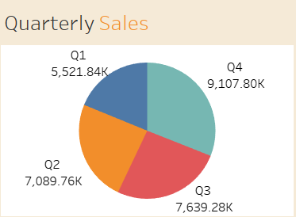
KPIs: Key Insights & Analysis/Actionable
Insights
Highest Sales: Sales in the Quarter 4 reached highest at 9,107.80K followed by Quarter 3.
Actionable
Identified huge drop in sales during Quarter 1 compared to Quarter 4
Lowest Sales : Quarter 1 experienced lowest Sales at 5,521.84K
Develop 2014 Action Plan: Create a plan focusing marketing and addressing potential challenges

Slide 9
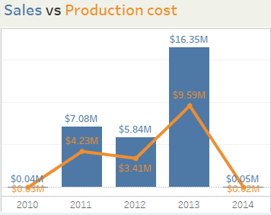


KPIs: Key Insights & Analysis/Actionable
Insights
2010: Sales to Production cost ratio was lower resulted in low profit margin
Actionable
The steep drop in Sales in 2014 is a major concern.
2014: Sales to Production cost ratio is higher compared to previous to 3years impacting the overall profit.
Focus on customer retention strategies during low sales months. Offer loyalty programs, or targeted marketing campaigns to boost sales.
Refer Sales Trend data of 2013 to plan and forecast the production for 2014 considering low turn over in 2014 January.
2011-2013: Overall, Sales to Production cost ratio was higher while Sales touching highest number in 2013 to $16.35M.

Slide 10
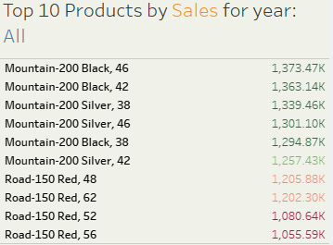




KPIs: Key Insights & Analysis/Actionable
Insights
Mountain-200 Dominance: Top 6 spots, led by Black colour, sizes 46,42,38
Actionable
Inventory: Prioritize Mountain-200 (Blk 46, 42, 38) & Road-150 Red (48).
Road-150 Red Emerging: Strong performance, especially size 48.
Color Preference: Black & Silver are top choices for Mountain bikes, Red for Road.
High Revenue: Top performers each generate >$1M in sales.
Product Dev: Innovate in the Mountain-200 line.
Sales: Upsell/cross-sell top models.
Marketing: Campaign focus on top series & colors.

Slide 11
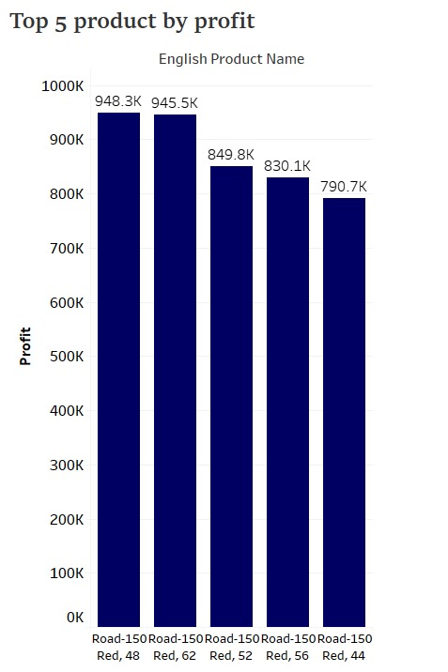
KPIs: Key Insights & Analysis/Actionable
Insights
Dominant Product Line: The "Road-150" line is the most profitable, with top models driven by "Red" color and sizes 48, 62, 52, 56, and 44.
Actionable
Enhance Cross-Selling Opportunities: Bundle the "Road-150 Red" with accessories or related products to boost sales, such as offering a discounted bike lock or helmet with the purchase of a "Road-150 Red”.
Top Performers: The "Road-150 Red, 48" and "Road-150 Red, 62" lead with profits of 948.3K and 945.5K. The "Road-150 Red, 44" has the lowest profit at 790.7K.
Develop Marketing: Increase stock levels for the most popular size or ensure that high-demand sizes are always available in high traffic channels

Slide 12
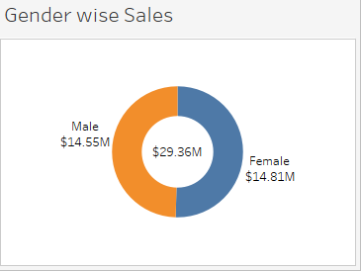
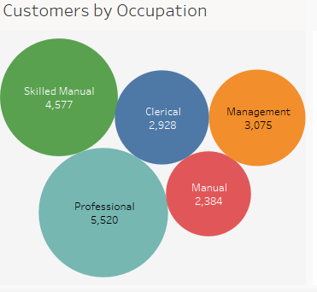
KPIs: Key Insights & Analysis/Actionable
Insights
Total Customers : 18.4k
Actionable
Customer Growth Analysis: With Female customers driving the highest sales, analyze Male customer feedback to identify improvement areas.
Highest Sales (Gender): Female customers lead in sales with $14.81M.
Highest Customer Count by Occupation: Professional customers are the largest group, totaling 5,520.
Lowest Customer Count by Occupation: Manual occupation customers are the smallest group, with 2,384.
Marketing Strategy: Boost marketing with new strategies and targeted ads, focusing on underperforming segments (by gender and occupation) to increase sales.

Slide 13
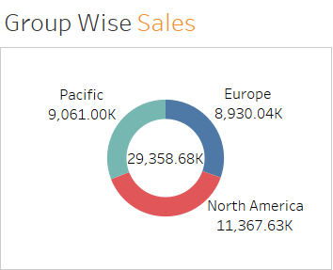
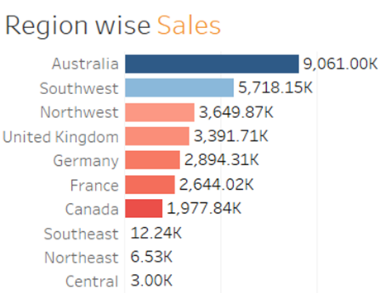
KPIs: Key Insights & Analysis/Actionable
Insights
Highest Sales (Group): From the Data, North America Region has the highest Sale of 11.37 M indicating consistent growth.
Actionable
Identify Growth Drivers: Determine factors that contributed to the high Sales of North America.
Lowest Sales (Region): Central with 3K Sales.
Develop 2014 Action Plan: Create a plan to advertise and address potential challenges.
Highest Sales (Region): Australia has the highest sales of 9.06 M.
Focus on Region wise strategies to boost sales also start promotional offers which will improve Sales in Central/Northeast region.

Slide 14
Financials
Year | Sales ($) | Production Cost ($) | Net profit ($)
2010 | $0.04M | $0.03M | $0.02M
2011 | $7.08M | $4.23M | $2.84M
2012 | $5.84M | $3.41M | $2.43M
2013 | $16.35M | $9.59M | $6.77M
2014 | $0.05M | $0.02M | $0.03M

Slide 15
Recommendation and Insights
Improved Decision-Making: The report helps identify top-performing products, regions, and customers, enabling the business to make informed decisions on inventory, marketing, and sales strategies.
Strategic Recommendations:
Focus marketing efforts on top-performing regions and customers.
Analyze seasonal sales trends to prepare for peak sales periods.
Adjust product offerings based on customer preferences and sales trends.

Slide 16
Conclusion
Summary: The Adventure Works report allows stakeholders to analyze product performance, customer behavior, and sales trends over time.
Key Takeaways:
Powerful insights into product performance and customer preferences.
Helps in optimizing sales strategies and business operations.
Next Steps:
Further analysis for predictive forecasting.
Ongoing optimization of sales strategies using data-driven insights.

Slide 17

Thank you

